Slide 1

MOT1421: Economic Foundations Oligopoly: the most common market structure
Examples:
Car (automobiles) market
Banks
Book publishing
Oil & gas industry
Media & social media
Tobacco industry
Search engines
Mobile phone providers
Airbus – Boeing (duopoly)
Coca Cola – PepsiCo
Kraft – Nestle –PepsiCo – Unilever
Breakfast cereals
Steel production
Etc. etc.

Slide 2
MOT1421: Economic Foundations Oligopoly: ‘fewness’; C4 = 0,89 (or 89%)

Slide 3
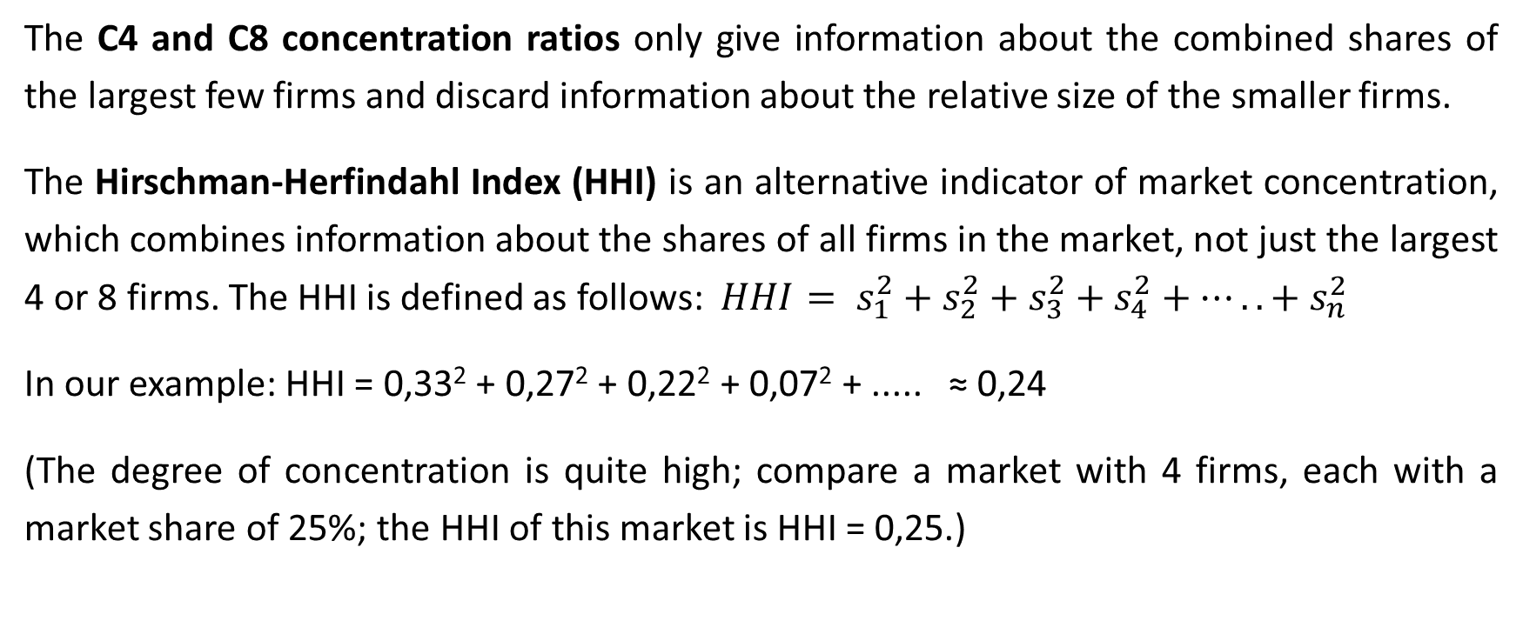
MOT1421: Economic Foundations Oligopoly
The C4 and C8 concentration ratios only give information about the combined shares of the largest few firms and discard information about the relative size of the smaller firms.
The Hirschman-Herfindahl Index (HHI) is an alternative indicator of market concentration, which combines information about the shares of all firms in the market, not just the largest 4 or 8 firms. The HHI is defined as follows: $HHI= s_{1}^{2}+s_{2}^{2}+s_{3}^{2}+s_{4}^{2}+…..+{ s}_{n}^{2}$
In our example: HHI = 0,33² + 0,27² + 0,22² + 0,07² + ..... ≈ 0,24
(The degree of concentration is quite high; compare a market with 4 firms, each with a market share of 25%; the HHI of this market is HHI = 0,25.)

Slide 4
MOT1421: Economic Foundations Oligopoly
Critical structural dimensions of oligopolistic markets include:
the number of firms (and their market shares)
the importance of product differentiation
entry/exit conditions (is entry possible? easy? costly?)
the legal conditions concerning collusion/cartels (antitrust law; competition policy)
the uncertainty (concerning the reactions of the other firms) faced by the individual firm and the strategies they may adopt to cope with it.
THERE ARE MANY ‘MODELS’ OF OLIGOPOLY (including the Cournot model)

Slide 5
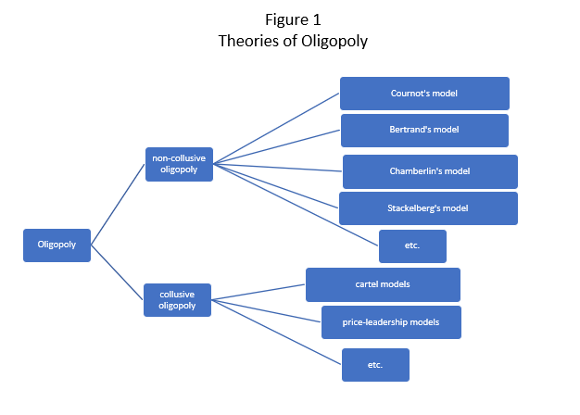
MOT1421: Economic Foundations Oligopoly: lack of uniformity

Slide 6
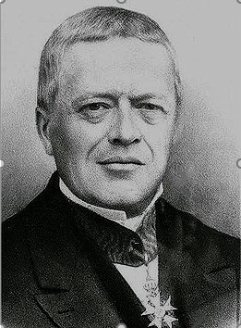
MOT1421: Economic Foundations Oligopoly: the Cournot model
Cournot’s model of oligopoly is based on the following assumptions:
There are only a few sellers and there are many buyers. The total supply of the product is concentrated in a few firms.
The product may be homogenous or differentiated. We assume here that the product is homogenous.
Each firm has clearly defined (total, average and marginal) cost functions.
The goal of the oligopolistic firms (ex hypothesi) is profit maximization. The condition for maximum profits is (as always): MR = MC.
Entry of new firms is blocked by definition.
Perfect knowledge, full transparency and complete information: the oligopolistic firms and all buyers have complete knowledge of the prevailing (and future) conditions of the market. Uncertainty is ruled out by assumption. There is also no asymmetric information, no insider knowledge etc.

Slide 7
MOT1421: Economic Foundations Oligopoly: the Cournot model
We assume that there are 2 firms (duopoly), producing an identical good. Total market demand is: Q = 140 – P . Total output Q = Qa + Qb.
We will focus on firm A (the case for firm B is analogous).
Market demand for firm A is: Qa = 140 – Qb – P ; hence, we get:
P = 140 – Qa – Qb
Total revenue of firm A = TRa = P*Qa = 140Qa – QaQa – QaQb
Marginal revenue of firm A: MRa = dTRa/Dqa = 140 – 2Qa - Qb

Slide 8
MOT1421: Economic Foundations Oligopoly: the Cournot model
Total cost of firm A is assumed to be: TCa = 800 + 20 Qa
Hence, marginal cost Mca = 20
Profit maximisation by firm A: MRa = MCa
140 – 2Qa – Qb = 20
Qa = 60 – ½ Qb reaction function of firm A
Likewise, we can derive: Qb = 60 – ½ Qa reaction function of firm B

Slide 9
MOT1421: Economic Foundations Oligopoly: Cournot equilibrium
To obtain the Cournot equilibrium, we substitute the reaction function of firm B in the reaction function of firm A:
Qa = 60 – ½ Qb = 60 – ½ [60 – ½ Qa] = 30 + ¼ Qa → Qa* = 40; Qb* = 40
Hence, the equilibrium P* = 60
Supernormal profits of A = TRa – TCa = 2400 – 1600 = 800
Supernormal profits of B = TRb – TCb = 2400 – 1600 = 800
Joint profits of firms A and B = 1600.

Slide 10
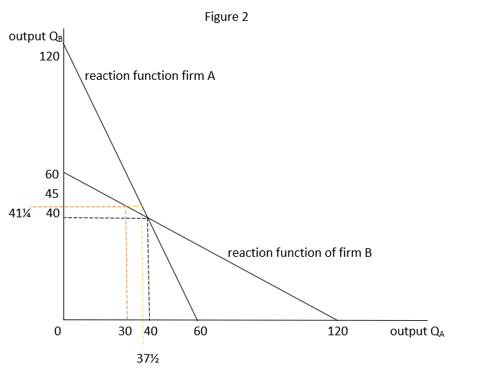
MOT1421: Economic Foundations Oligopoly: stability; firm A produces 30 and then ...

Slide 11
MOT1421: Economic Foundations Oligopoly: cartel outcome (= monopoly)
Firm A and firm B form a cartel (illegal); they act as 1 firm.
Market demand: Q = 140 – P
Total cost TC = 1600 + 20Q NOTE: fixed costs !!!
This gives:
TR = PQ = (140 – Q)Q = 140Q – Q²; hence MR = 140 – 2Q
MC = 20
MR = MC → 140 – 2Q = 20 → Q = 60; P = 80; total profits = 2000
Interpretation: the cartel acts as a monopoly; joint output is restricted to 60 (instead of 80), the price P is higher (80 instead of 60); each firm has profits of 1000 (due to coordination)

Slide 12
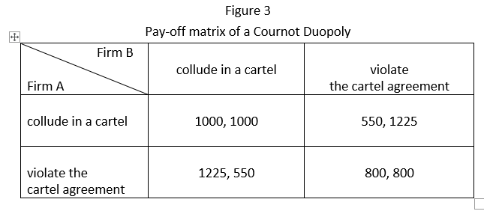
MOT1421: Economic Foundations Oligopoly: Nash equilibrium; dominant strategy
Cournot non-cooperative
Outcome = 800, 800.
Cartel outcome = 1000, 1000
(maximum joint profits)

